Slide 1

Python Machine Learning: Logistic Regression
Žydrūnė Kelpšaitė
Data Analyst

Slide 2
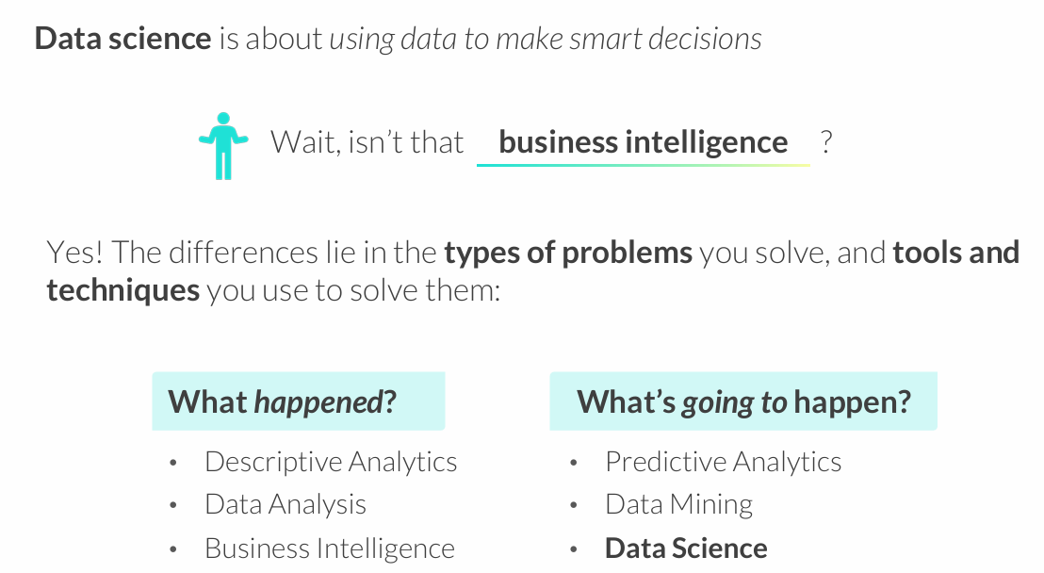
WHAT IS DATA SCIENCE?

Slide 3
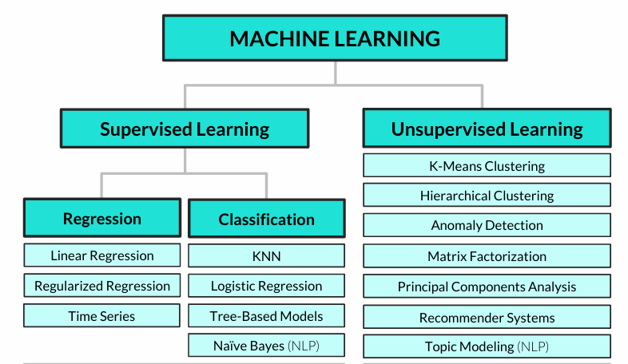
Common machine learning algorithms

Slide 4
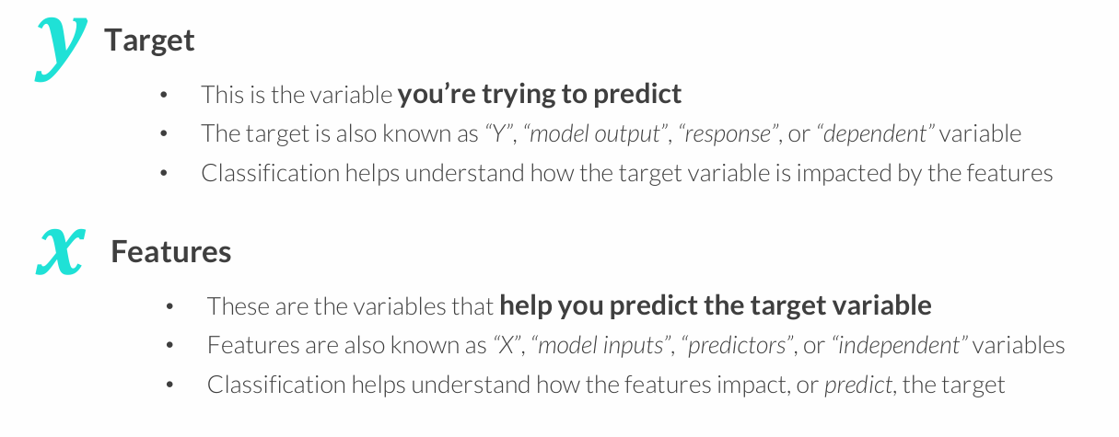
CLASSIFICATION 101
Classification analysis is a supervised learning technique used to predict a categorical variable (target) by modeling its relationship with other variables (features)

Slide 5
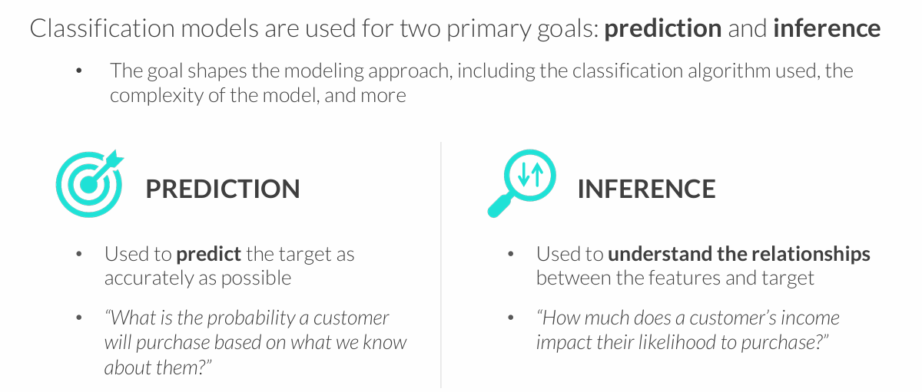
GOALS OF CLASSIFICATION
You often need to strike a balance between these goals – a model that is very inaccurate won’t be too trustworthy for inference, and understanding the impact that variables have on predictions can help make them more accurate

Slide 6
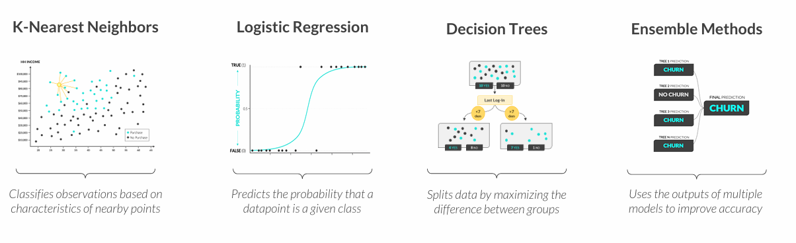
TYPES OF CLASSIFICATION
These are some of the most common types of classification modeling techniques:
All models are wrong, but some are useful
George Box

Slide 7
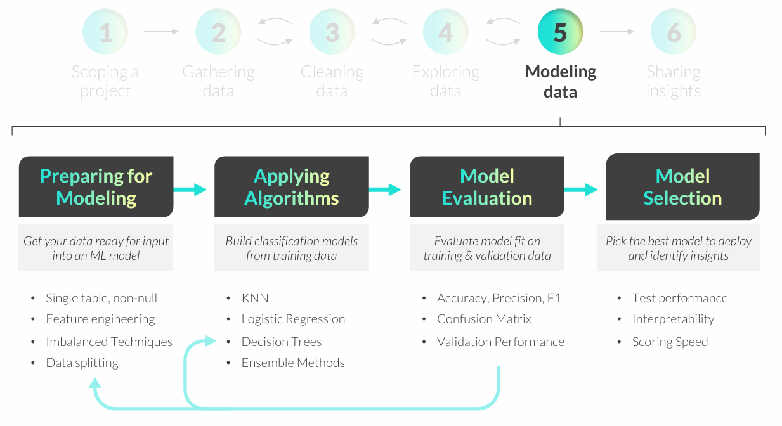
CLASSIFICATION MODELING WORKFLOW

Slide 8
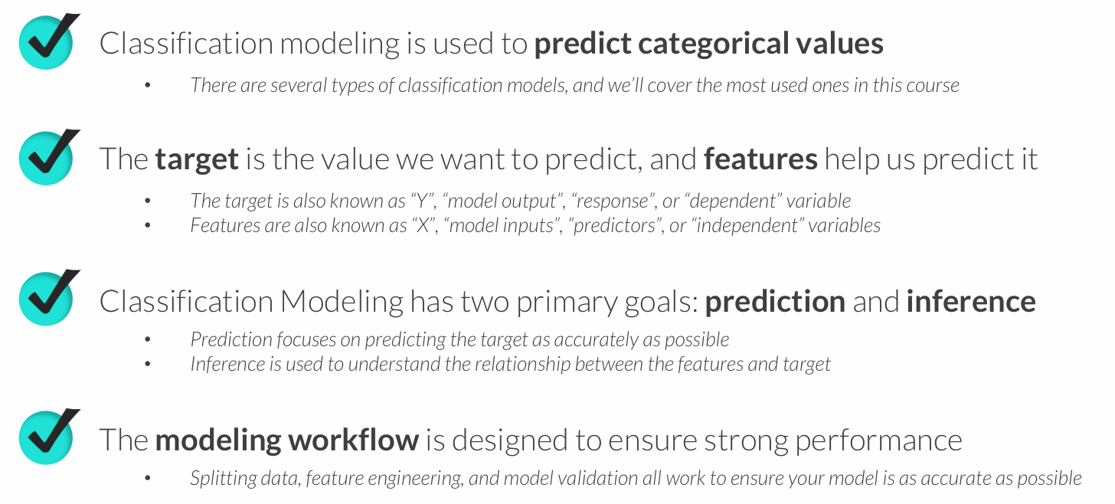
KEY TAKEAWAYS

Slide 9
K-NEAREST NEIGHBORS (KNN)
K-Nearest Neighbors (KNN) is a classification technique designed to predict outcomes based on similar observed values
• In its simplest form, KNN creates a scatter plot with training data, plots a new unobserved value, and assigns a target class based on the classes of nearby points
• K represents the number of nearby points (or “neighbors”) the model will consider when making a prediction
Example use cases:
• Predicting which customers will purchase a product based on demographics
• Classifying customers into pre-existing clusters or segments

Slide 10
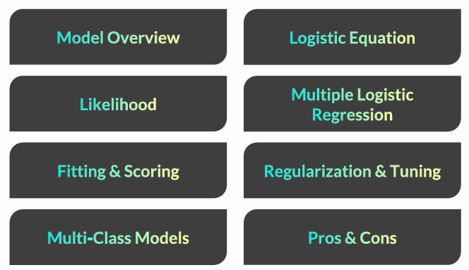
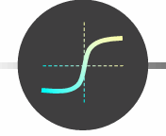
LOGISTIC REGRESSION

Slide 11
LOGISTIC REGRESSION
Logistic Regression is a classification technique used to predict the probability of a binary (true/false) outcome
• In its simplest form, logistic regression forms an S-shaped (sigmoid) curve between 0 and 1, which represents the probability of a TRUE outcome for any given value of X
• The likelihood function measures how accurately a model predicts outcomes, and is used to optimize the “shape” of the curve
• Although it has the word “regression” in its name, logistic regression is not used for predicting numeric variables
Example use cases:
• Flagging spam emails or fraudulent credit card transactions
• Determining whether to serve a particular ad to a website visitor

Slide 12
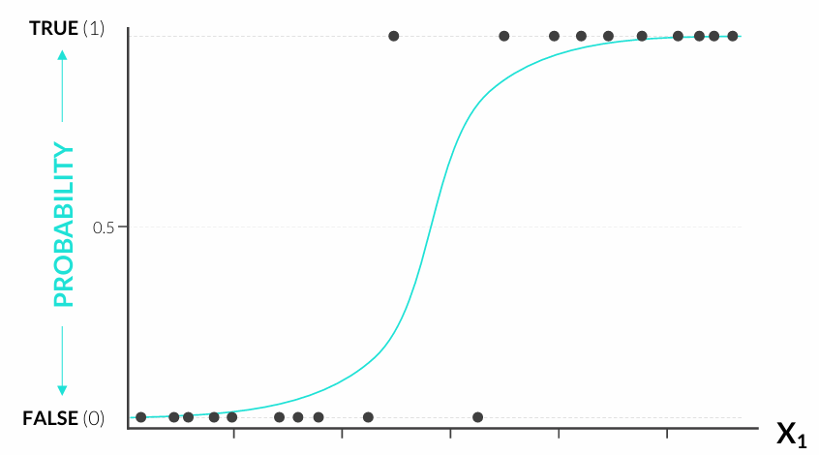
LOGISTIC REGRESSION
Logistic regression plots the best-fitting curve between 0 and 1, which tells us the probability of Y being TRUE for any given value of X1

Slide 13
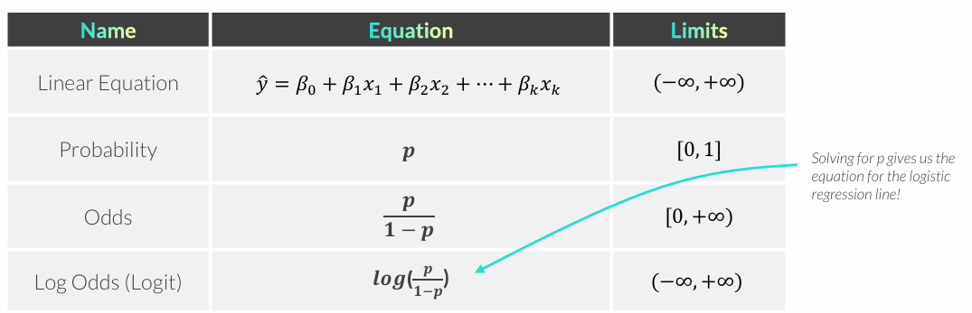
LOGISTIC VS LINEAR REGRESSION
Logistic regression and linear regression are both linear models, but logistic regression outputs probability, which is bounded by 0 and 1
• The logit transformation helps convert linear model outputs to probabilities
Log Odds (The Logit Function) links probability to a linear combination of features which has an output between 0 and 1

Slide 14
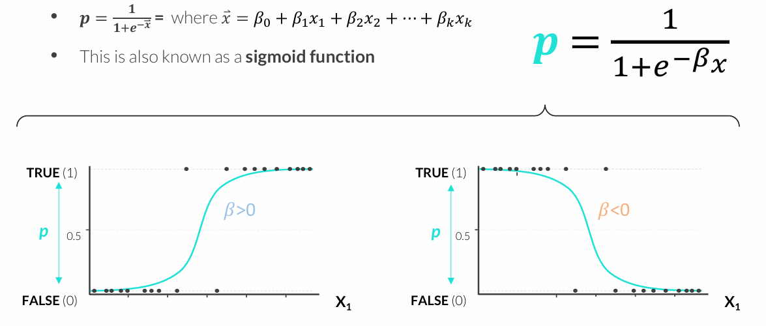
LOGISTIC EQUATION
The logistic equation solves for probability by setting log odds to a linear combination of features and solving for p

Slide 15
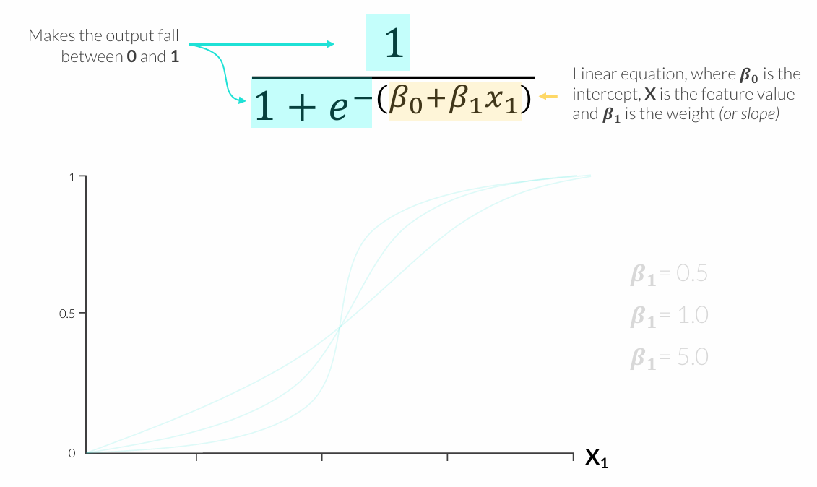
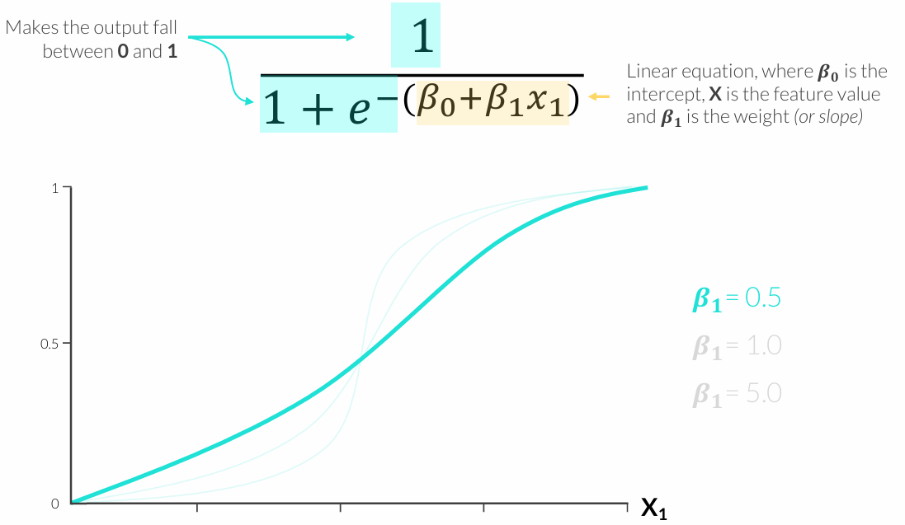
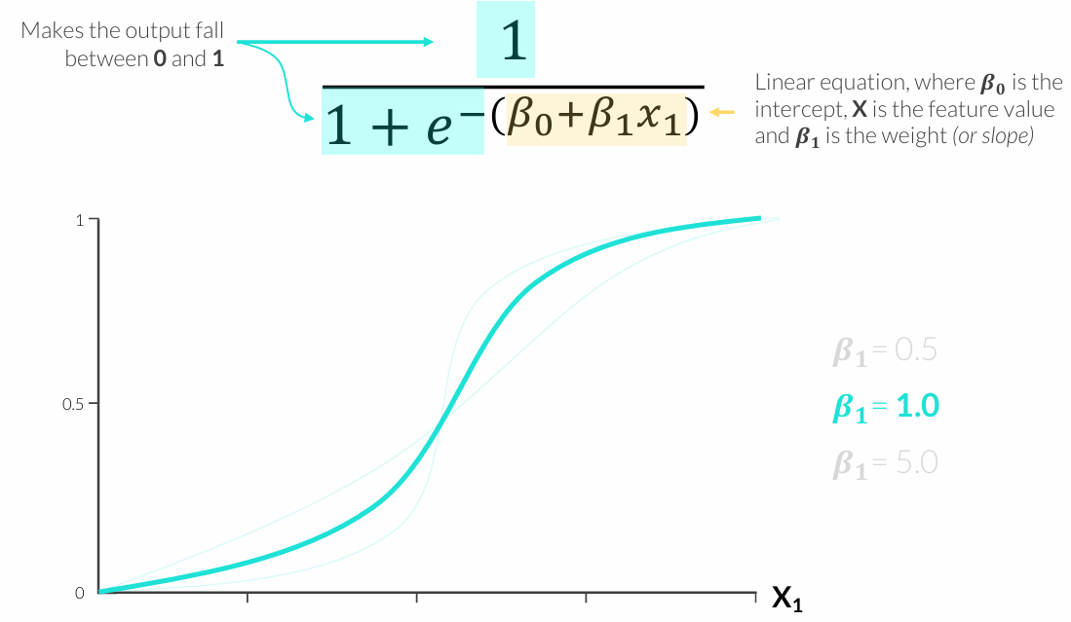
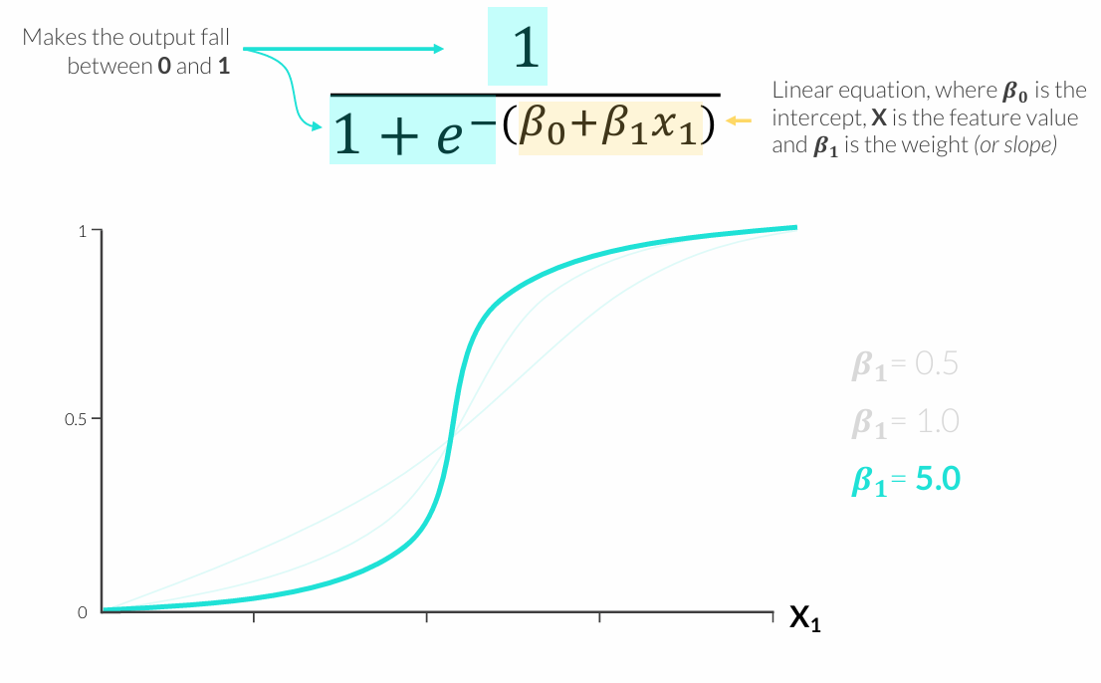
LOGISTIC EQUATION

Slide 16
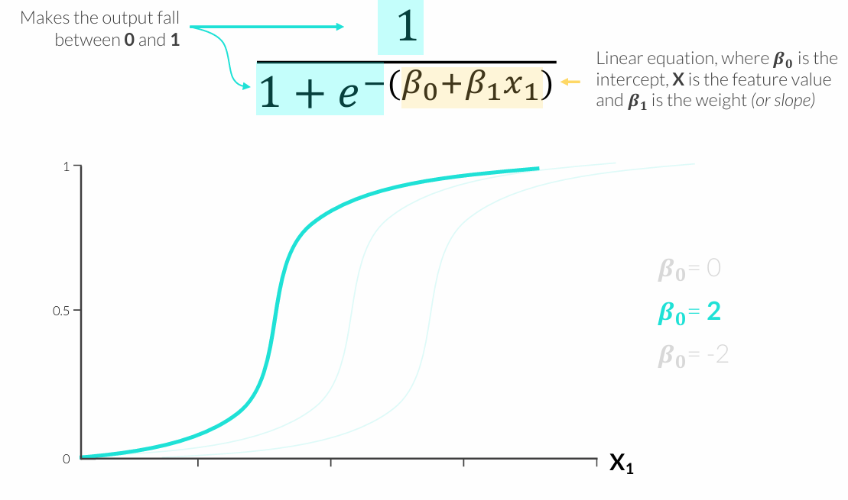
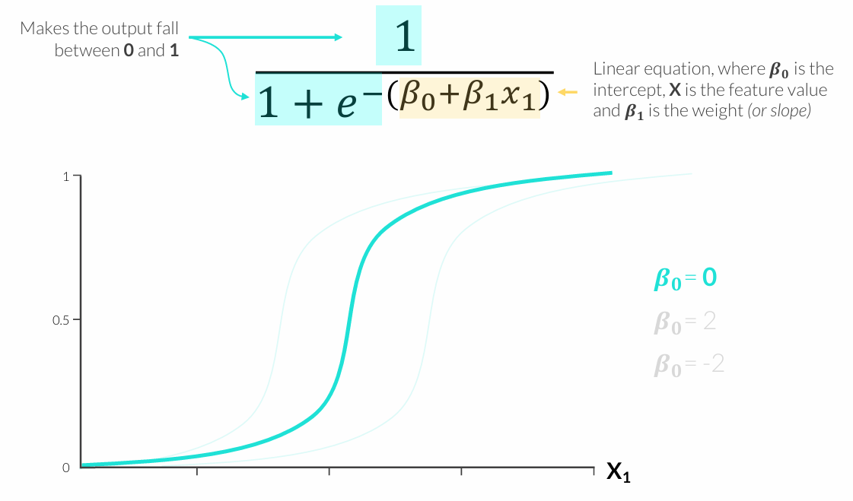
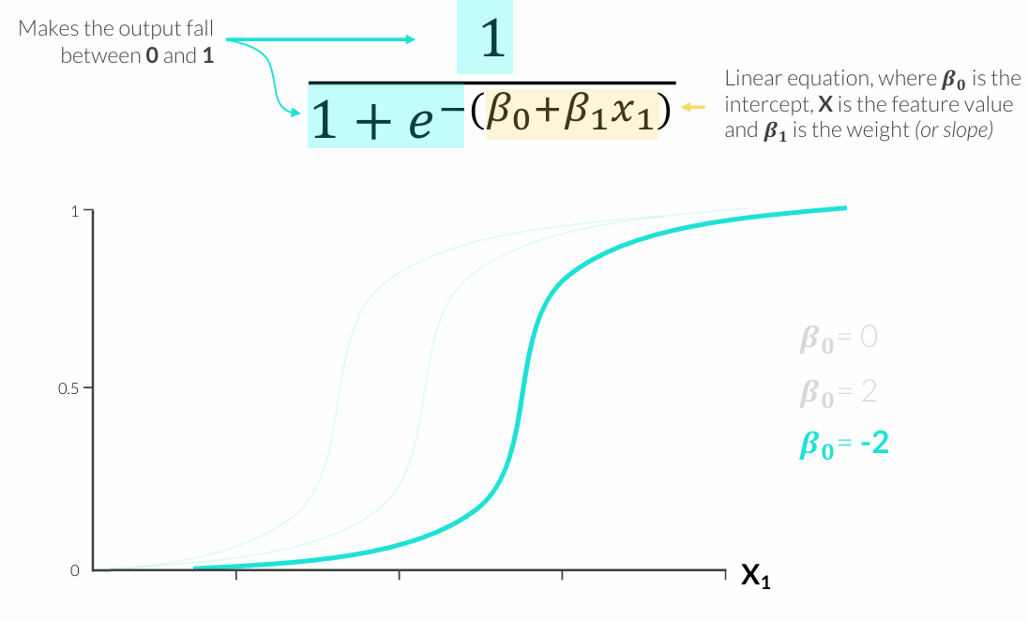
LOGISTIC EQUATION
Notes:
Intercept 0

Slide 17
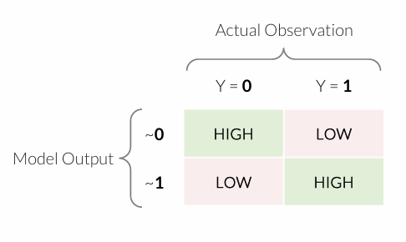
LIKELIHOOD
How do we determine the “right” values for 𝛽?
• Likelihood is a metric that tells us how good our model is at correctly predicting Y, based on the shape of the curve
• This is where machine learning comes in; instead of human trial-and-error, an algorithm determines the best weights to maximize likelihood using observed values
• When our model output is close to the actual Y, we want likelihood to be HIGH (near 1)
• When our model output is far from the actual Y, we want likelihood to be LOW (near 0)
Notes:
Tikėtinumas – ne tikimybė
Tikimybė – P(duomenys | parametrai žinomi)
Tikėtinumas – L(parametrai | duomenys fiksuoti)
Logistinėje regresijoje:
Maksimizuojamas tikėtinumas
Arba minimizuojamas neigiamas log tikėtinumas (log loss)

Slide 18
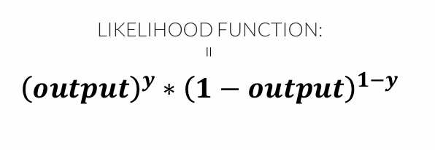
LIKELIHOOD
How do we determine the “right” values for 𝛽?
• Likelihood is a metric that tells us how good our model is at correctly predicting Y, based on the shape of the curve
• This is where machine learning comes in; instead of human trial-and-error, an algorithm determines the best weights to maximize likelihood using observed values
Notes:
Likelihood funkcijos lygtis
output – modelio prognozuota tikimybė (0–1)
y – tikroji klasė (0 arba 1)
Formulė parenka teisingą tikimybę pagal tikrą klasę:
jei y = 1, lieka output
jei y = 0, lieka 1 − output
Idėja: modelis mokosi taip, kad tikriems įvykiams priskirtų dideles tikimybes, o neįvykiams – mažas.

Slide 19
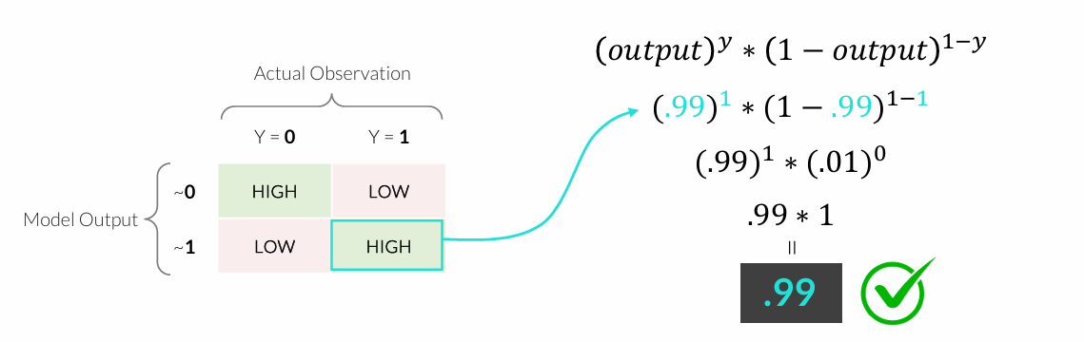
LIKELIHOOD
How do we determine the “right” values for 𝛽?
• Likelihood is a metric that tells us how good our model is at correctly predicting Y, based on the shape of the curve
• This is where machine learning comes in; instead of human trial-and-error, an algorithm determines the best weights to maximize likelihood using observed values

Slide 20
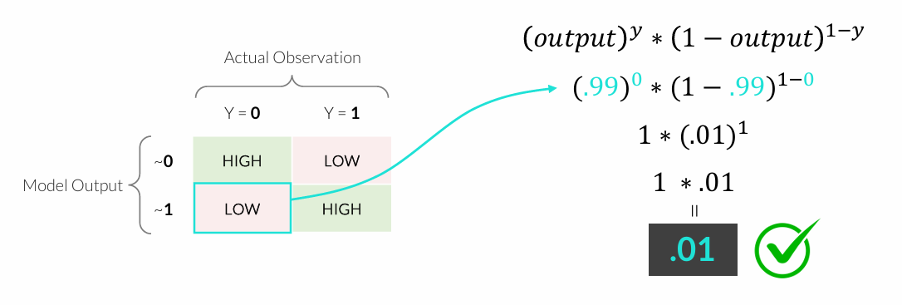
LIKELIHOOD
How do we determine the “right” values for 𝛽?
• Likelihood is a metric that tells us how good our model is at correctly predicting Y, based on the shape of the curve
• This is where machine learning comes in; instead of human trial-and-error, an algorithm determines the best weights to maximize likelihood using observed values

Slide 21
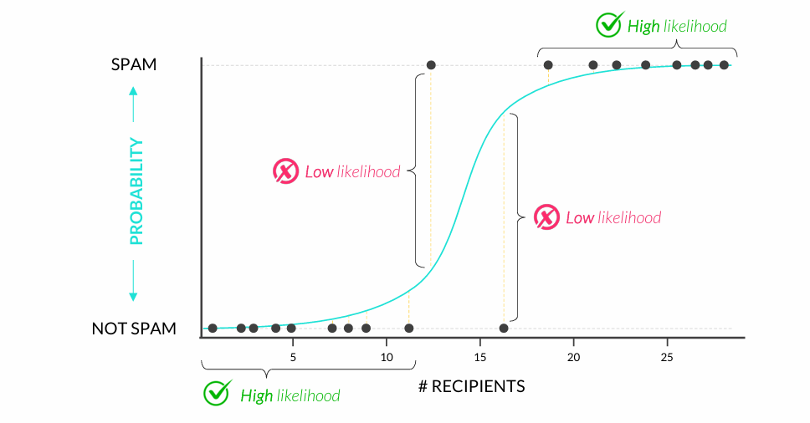
LIKELIHOOD
Observations closest to the curve have the highest likelihood values (and vice versa), so maximizing total likelihood allows us to find the curve that fits our data best

Slide 22
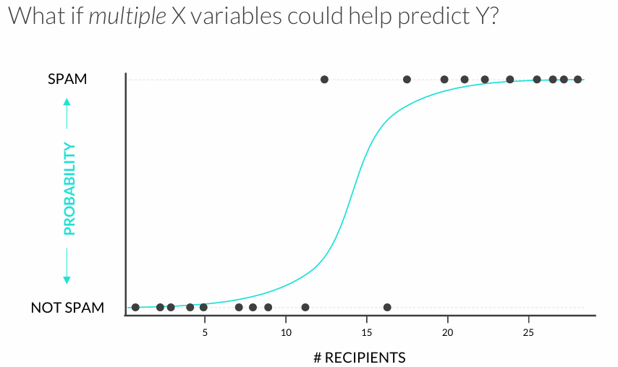
MULTIPLE LOGISTIC REGRESSION
# of Recipients can help us detect spam, but so can other variables like the number of typos, count of words like “free” or “bonus”, sender reputation score, etc.

Slide 23
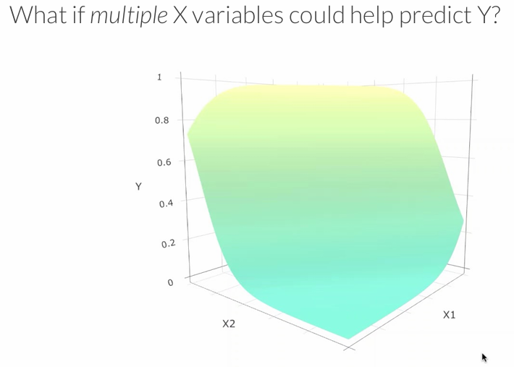
MULTIPLE LOGISTIC REGRESSION
Logistic regression can handle multiple features, but visual interpretation breaks down at >2 features (this is why we need machine learning!)

Slide 24
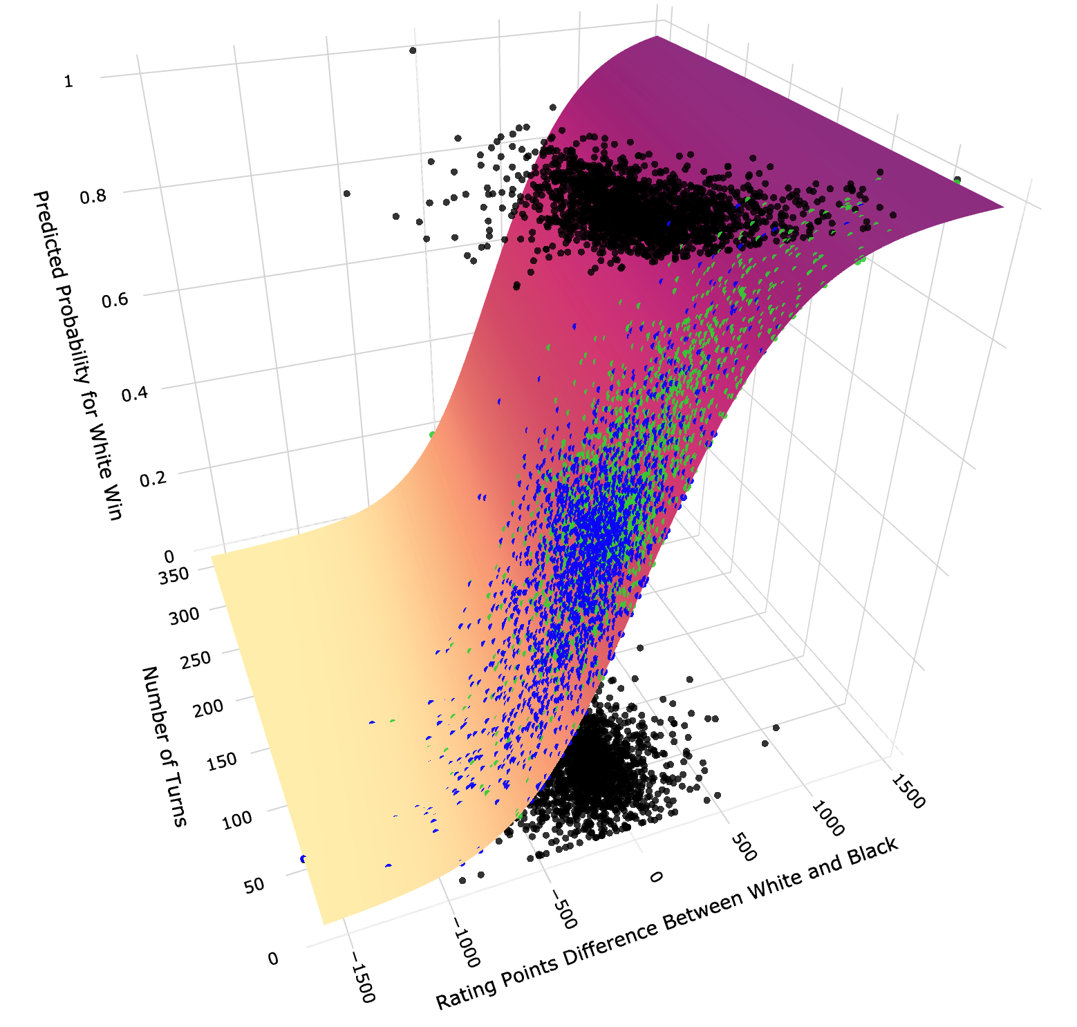
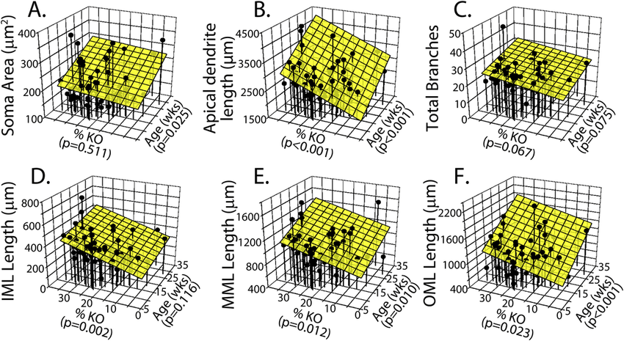
MULTIPLE LOGISTIC REGRESSION

Slide 25
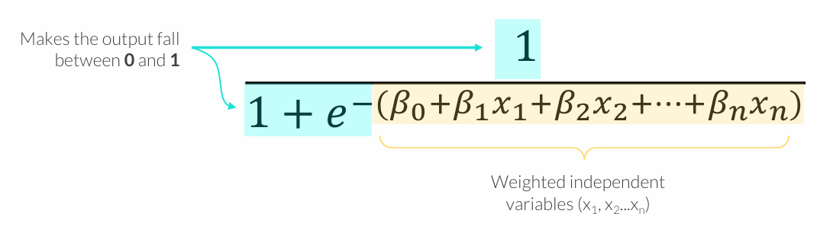
MULTIPLE LOGISTIC REGRESSION
What if multiple X variables could help predict Y?
Logistic regression is about finding the best combination of weights (𝛽1, 𝛽2...𝛽𝑛) for a given set features (x1, x2...x𝑛) to maximize the likelihood function

Slide 26
LOGISTIC REGRESSION WORKFLOW
Follow the logistic regression workflow to ensure that you fit an accurate model:
Split training and test datasets to accurately assess model performance
Scale or standardize the data if you are going to use regularization
Fit & Tune the model by adding or removing features and adjusting the regularization hyperparameters
Score the model on the test data after fitting your final model on the combined training & validation sets

Slide 27
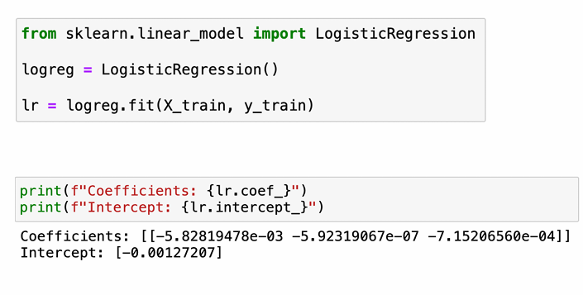
FITTING A LOGISTIC REGRESSION MODEL
In Python, you can fit a logistic regression model using the scikit-learn library
• Sklearn.linear_model.LogisticRegression()
• model.coef_ and model.intercept_ return the fitted coefficients and intercept
All coefficients are negative, which doesn’t make sense given the positive correlations between Purchase, Age, and Estimated Salary

Slide 28
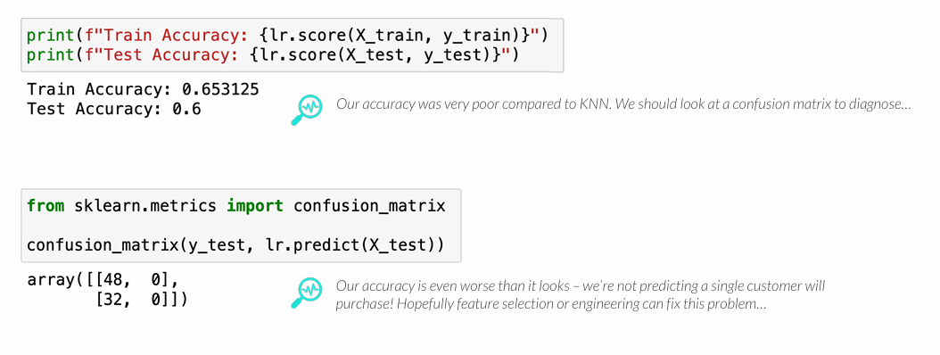
SCORING MODEL ACCURACY
In Python, you can fit a logistic regression model using the scikit-learn library
• model.score(X, y) returns an accuracy score for a given set of features and target values
• confusion_matrix(y_actual, y_pred) returns a confusion matrix

Slide 29
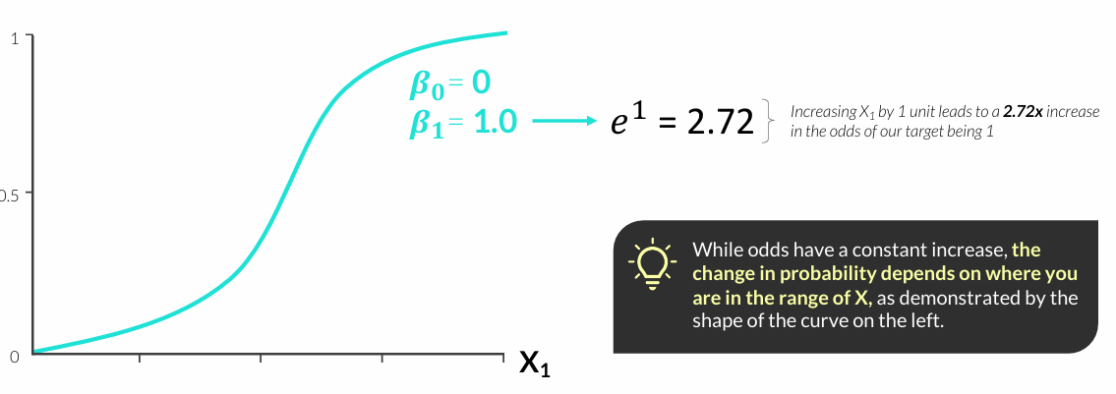
INTERPRETING COEFFICIENTS
The coefficients of a logistic regression model represent the change in log odds
• Positive coefficients mean the predicted probability increases as the feature increases
• Negative coefficients means the predicted probability decreases as the feature increases
• The odds ratio, calculated by exponentiating the coefficient, represents the multiplicative change in odds caused by a one unit increase in the feature

Slide 30
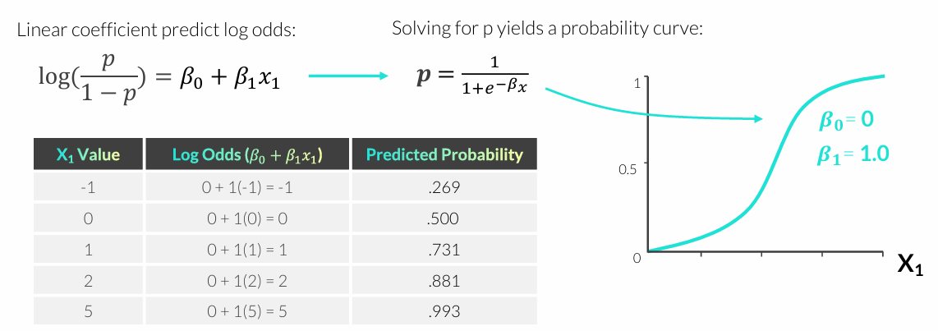
INTERPRETING COEFFICIENTS
The coefficients of a logistic regression model represent the change in log odds
• Positive coefficients mean the predicted probability increases as the feature increases
• Negative coefficients means the predicted probability decreases as the feature increases
• The odds ratio, calculated by exponentiating the coefficient, represents the multiplicative change in odds caused by a one unit increase in the feature

Slide 31
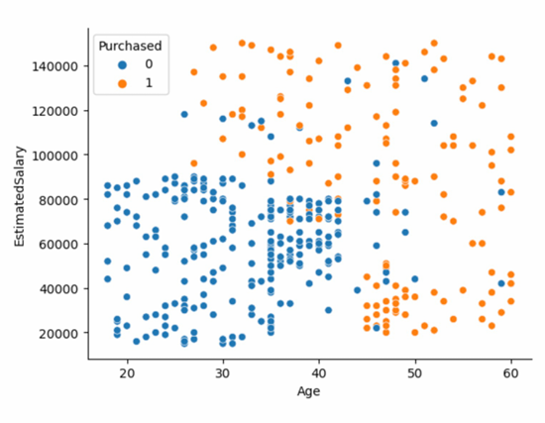
FEATURE ENGINEERING & SELECTION
Feature engineering is a critical part of the modeling process
• Thorough EDA, an understanding of ML algorithms, and subject matter expertise can all help with feature engineering and selection
Purchasers don’t always have high income or age – there is an interaction between these variables.
KNN works very well for this type of data, but logistic regression coefficients estimate a constant increase or decrease across continuous features. Feature engineering may help here!

Slide 32
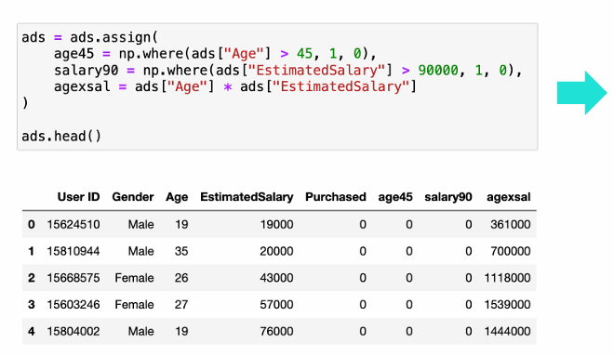
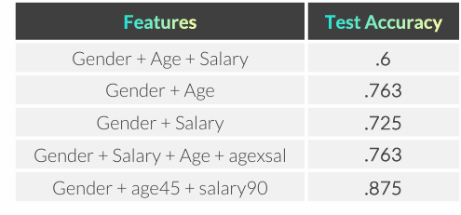
FEATURE ENGINEERING & SELECTION
Feature engineering is a critical part of the modeling process
• Thorough EDA, an understanding of ML algorithms, and subject matter expertise can all help with feature engineering and selection
Our model that used hard cut points as features performed much better than ones using continuous features

Slide 33
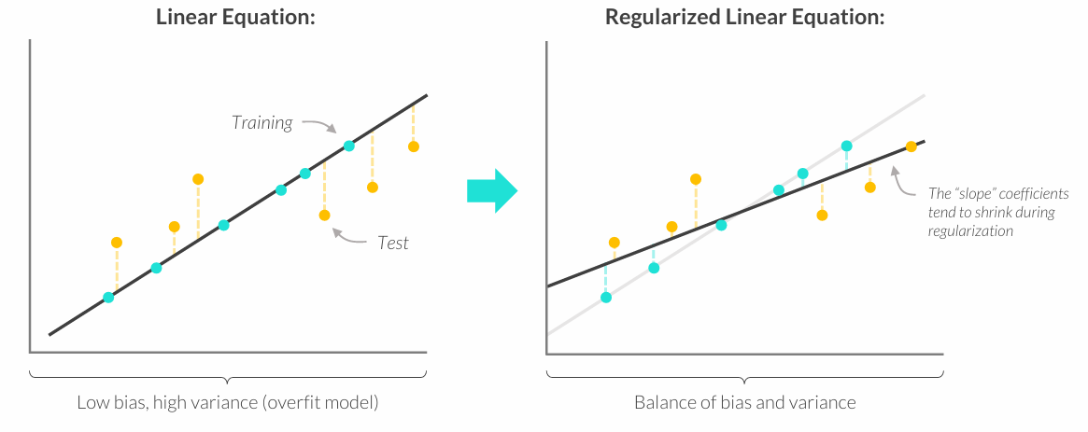
REGULARIZATION
Regularized models intentionally underfit training data by NOT choosing the model that best fits training data, with the purpose of reducing the variance in the test data
• This helps reduce overfitting and leads to better predictions (especially in smaller data sets)

Slide 34
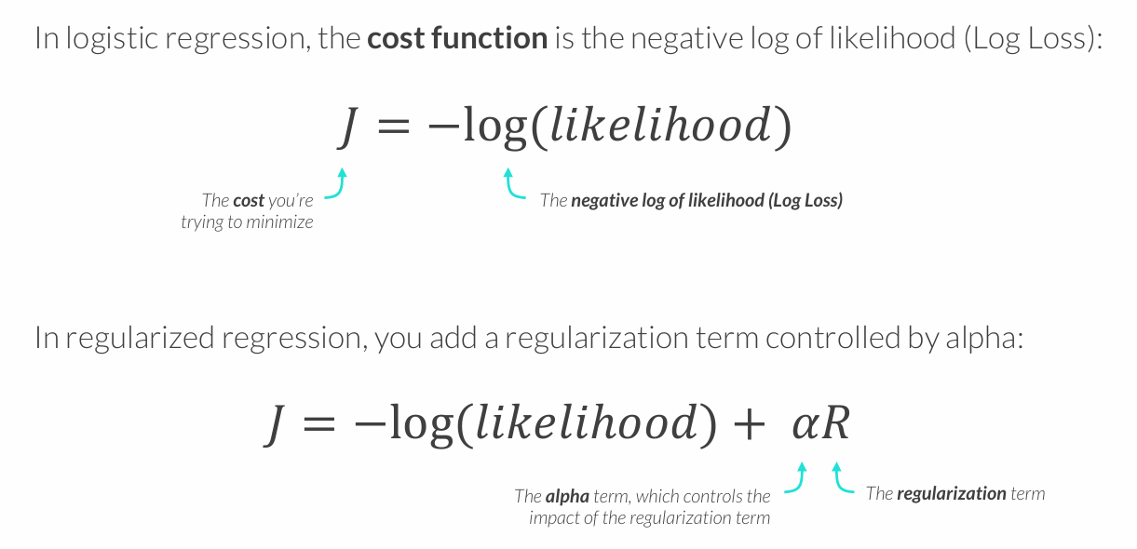
THE COST FUNCTION

Slide 35
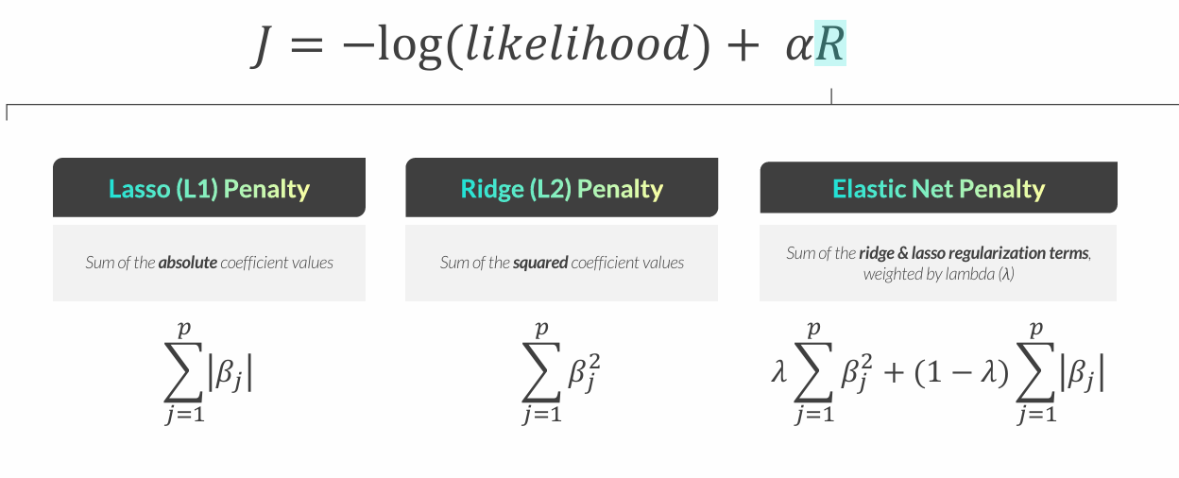
TYPES OF REGULARIZED REGRESSION
Different types of regularized regression have different regularization equations

Slide 36
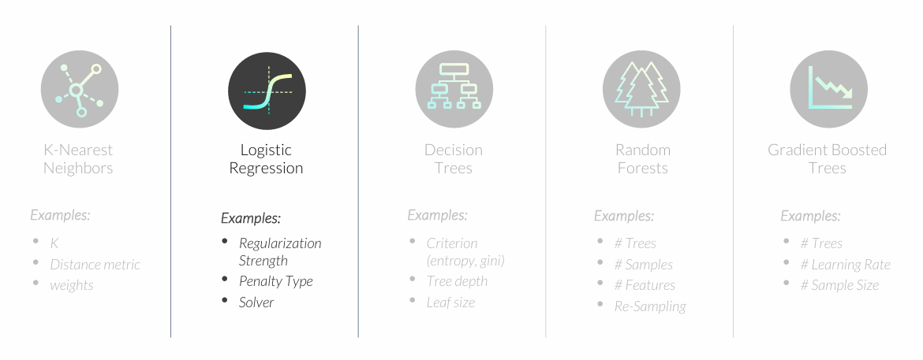
TUNING A REGULARIZED MODEL
Hyperparameters are settings that affect how well a model fits the data
• Unlike model parameters (like regression coefficients) these are not learned from the data
• Parameters are set before the model is fit and optimized based on validation performance

Slide 37
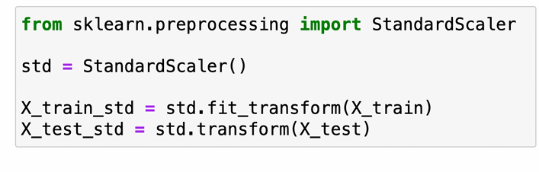
TUNING A REGULARIZED MODEL
Tuning a regularized logistic regression model can help prevent overfitting and lead to better out of sample performance
• Feature scaling is required prior to fitting your model because regularization impacts coefficient magnitudes, which are related to feature unit scales

Slide 38
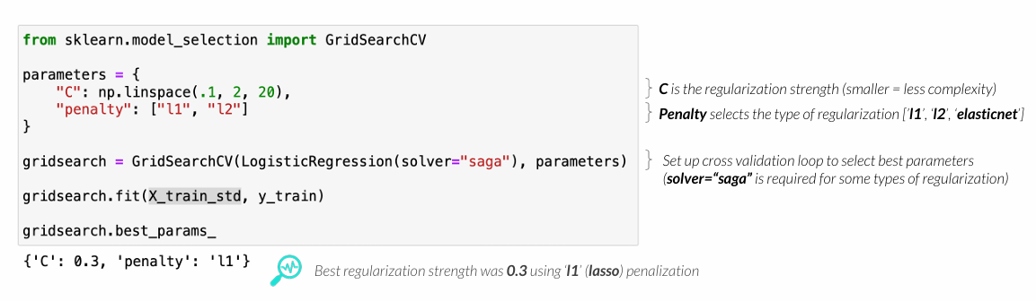
TUNING A REGULARIZED MODEL
Tuning a regularized logistic regression model can help prevent overfitting and lead to better out of sample performance
• After scaling, we’ll use GridSearchCV to test combos of regularization strength and type
• LogisticRegression(C=1.0, penalty=‘l2’, solver=“saga”)
Notes:
LogisticRegression(C=1.0, penalty='l2', solver="saga")
C = 1.0 – reguliacijos stiprumas. Kuo mažesnė C parametro reikšmė, tuo stipresnė reguliacija (modelis labiau riboja koeficientus ir mažina overfitting).
penalty = 'l2' – L2 reguliacija (Ridge). Ji baudžia didelius koeficientus, todėl modelis tampa stabilesnis ir mažiau linkęs per daug prisitaikyti prie treniravimo duomenų.
solver = "saga" – optimizavimo algoritmas, kuris randa geriausius modelio koeficientus. saga gerai veikia su didesniais duomenų rinkiniais ir palaiko įvairius reguliacijos tipus.
Logistinėje regresijoje yra keli solveriai (pvz., liblinear, lbfgs, saga).
Jie visi daro tą patį – padeda modeliui išmokti parametrus, tik naudoja skirtingą skaičiavimo būdą.
numpy.linspace(start, stop, num=50, endpoint=True, retstep=False, dtype=None, axis=0, *, device=None)[source]
Return evenly spaced numbers over a specified interval.

Slide 39
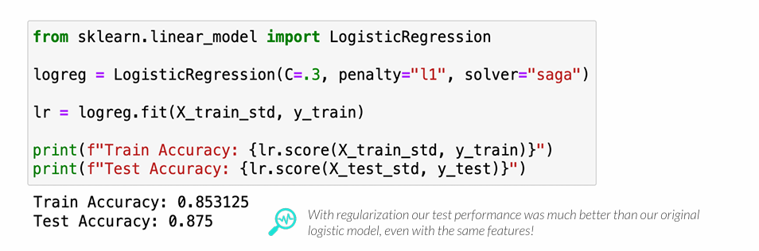
TUNING A REGULARIZED MODEL
Tuning a regularized logistic regression model can help prevent overfitting and lead to better out of sample performance
• After scaling, we’ll use GridSearchCV to test combos of regularization strength and type
• LogisticRegression(C=1.0, penalty=‘l2’, solver=“saga”)

Slide 40
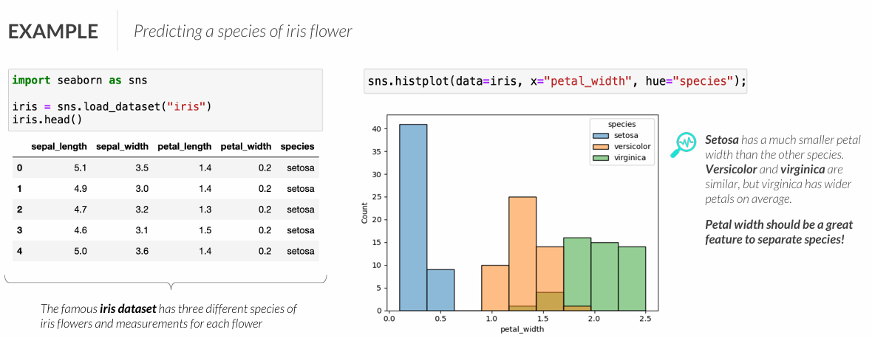
MULTI-CLASS LOGISTIC REGRESSION
Can I use logistic regression to predict multiple classes?
• Logistic regression can also be used for multi-class classification problems
• These are less common in business settings and tend to be more challenging

Slide 41
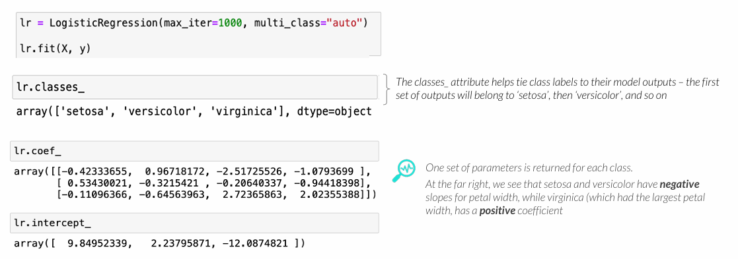
MULTI-CLASS LOGISTIC REGRESSION
Can I use logistic regression to predict multiple classes?
• LogisticRegression(multi_class=“auto”)
• Logistic regression is only capable of predicting binary outcomes, so one model will be fit for each class with the others grouped as the negative class

Slide 42
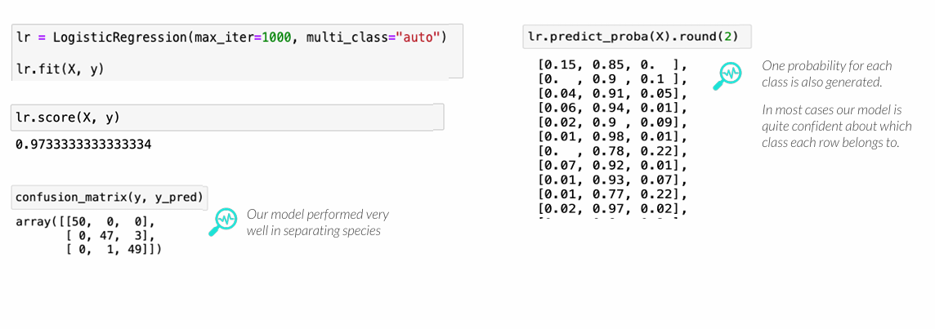
MULTI-CLASS LOGISTIC REGRESSION
Can I use logistic regression to predict multiple classes?
• LogisticRegression(multi_class=“auto”)
• Logistic regression is only capable of predicting binary outcomes, so one model will be fit for each class with the others grouped as the negative class

Slide 43
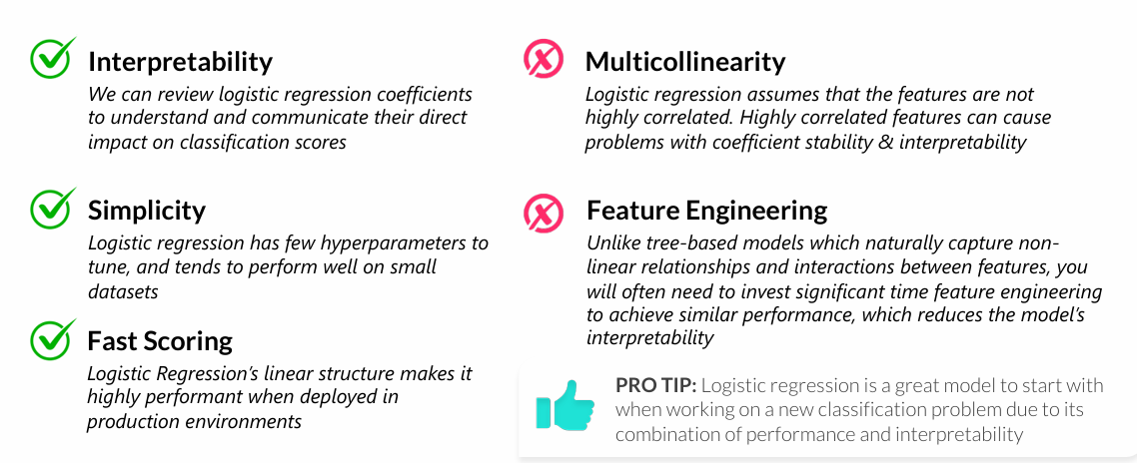
PROS & CONS OF LOGISTIC REGRESSION
Logistic regression has some pros and cons that data scientists should be aware of when deciding whether it is the best model for the task at hand
• In general, logistic regression is a great choice for classification and is among the most commonly used algorithms; however, it tends to be less accurate than ensembled trees

Slide 44
KEY TAKEAWAYS
Logistic Regression is a linear classification model
• It is highly interpretable and simple in structure, although it tends to underperform ensembled trees
The Logit Link Function constrains model outputs between 0 and 1
• Understanding this link is the key to being able to interpret model coefficients
Regularization hyperparameters can be tuned to reduce overfitting
• Regularization penalizes model complexity and has the impact of shrinking model coefficients, which can lead to better out of sample model performance
Multiclass logistic regression allows us to model more complex problems
• Multiclass logistic regression models are actually a series of binary models, rather than a single model with three possible outcomes

Slide 45
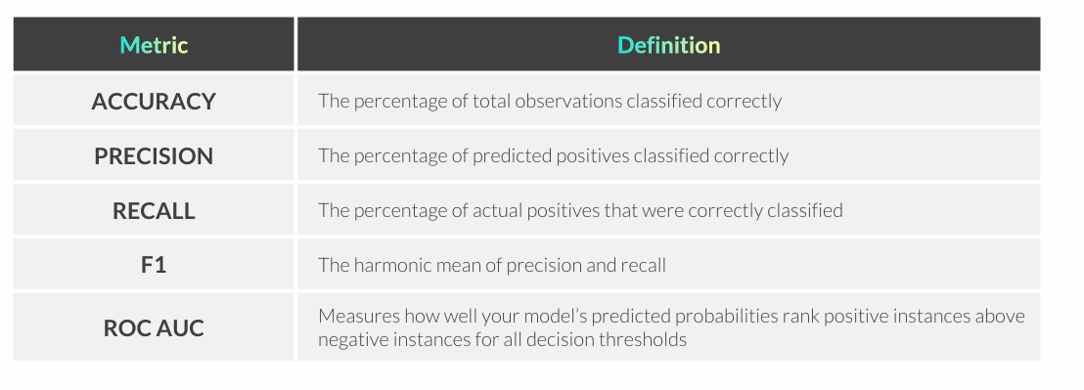
MODEL SELECTION & METRICS
Model selection describes the process of training multiple models, comparing performance on Test data, and choosing the best option
• When comparing performance, it’s important to prioritize the most relevant metrics based on the business context and the problem you are trying to solve

